Slide 1
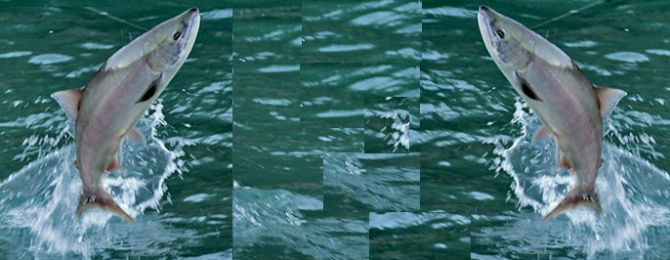
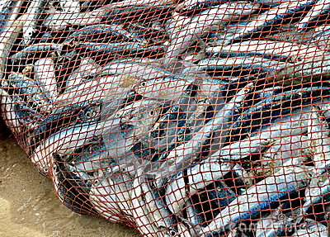
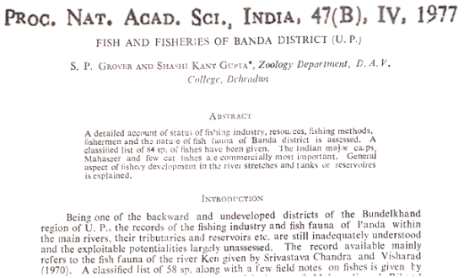
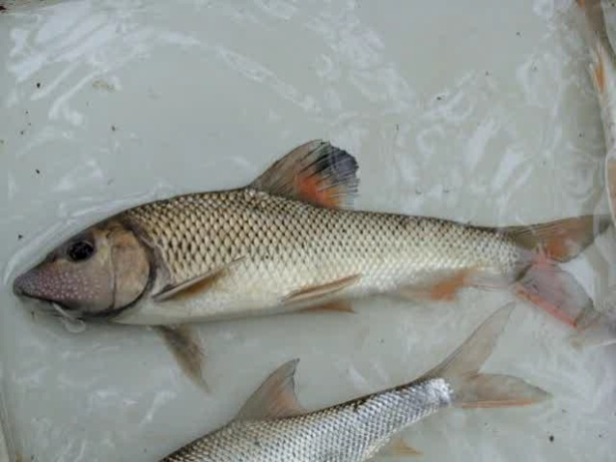
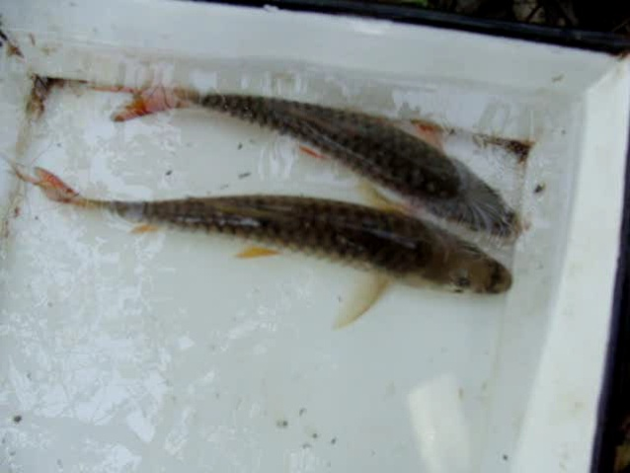
eRL;
FISH
eNyh
&
ekfRl;dh
FISHERIES
eNyh& ikyu
F
I
S
H
- Far Abundant [ about 35, 315; 50% of all vertebrates]
- Inhabiting
- Solely
Hydrosphere
[Fresh, Brackish & Marine]

Slide 2
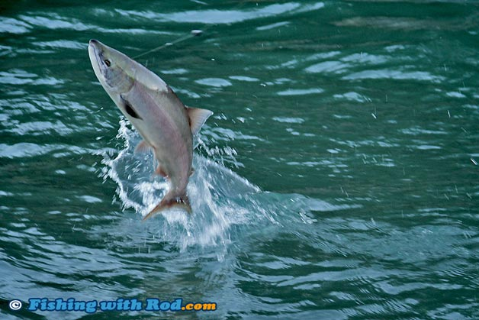
F I S H
eRL;
eNyh
“a poikilothermic, aquatic chordate with appendages (when present) developed as fins, whose chief respiratory organs are gills and whose body is usually covered with scales”. [ TM Berra, 2001, Freshwater fish distribution.]
‘aquatic vertebrates that have gills throughout life and limbs if any in the shape of fins’. [Nelson, 2006]
ICHTHYOLOGY = The Study of fishes.
ICHTHYOLOGIST = A student of fish systematics or dealing with the dimensions of Ichthyology.

Slide 3
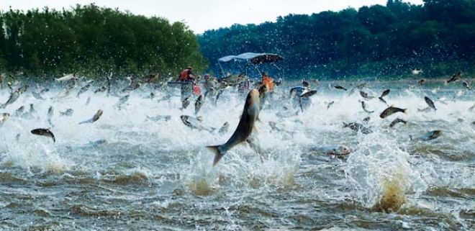
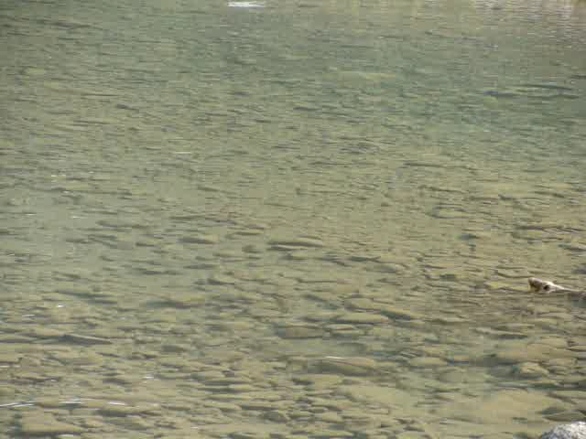
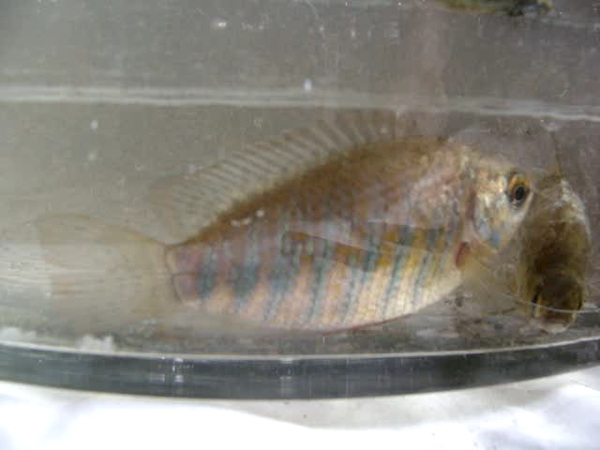
FISHES
FISH
VS
FISHES = Individuals of more than one species.
FISH = One or more individuals of one species e.g., 100 individuals of Labeo rohita.

Slide 4

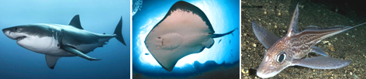
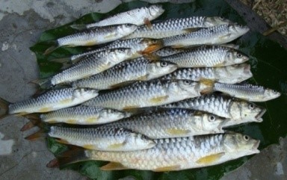
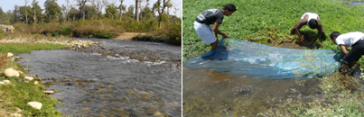
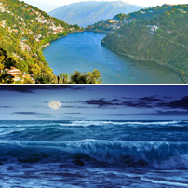
NUMBER
D I V E R S I TY
fofo/krk
About 27, 977 valid sp.
JAWLESS 108 : 70 Hagfishes and 38 Lampreys
CARTILAGINOUS FISHES: 970 Sharks 403 Skates and Rays 534
Chimaeras 33
BONY FISHES
26, 000+
FROM TROPICS TO
POLAR REGIONS
FRESH
BRACKISH
MARINE
HABITAT
FRESHWATER - 11,952 species (43%).
MARINE -15,800 species.
UP TO AN ELEVATION of 5,200 m in hot Springs of Tibet .
IN THE WORLD'S HIGHEST (3,812 m) LAKE: Titicaca (South America).

Slide 5
HABITAT
D I V E R S I T Y
fofo/krk
In the world's DEEPEST BAIKAL LAKE (at least 1,000 m).
In HOT SODA LAKE Magadi (Kenya) at temp. up to 42.5°C.
Under the ANTARCTIC ICE SHEET: At about -2°C (=
cryopelagic)[e.g., Cod ice fish Trematomus].
AIR-BREATHING in the SWAMPS.
LAKE-DWELLING: Deep, cold, Oligotrophic , Mesotrophic and Eutrophic.

Slide 6
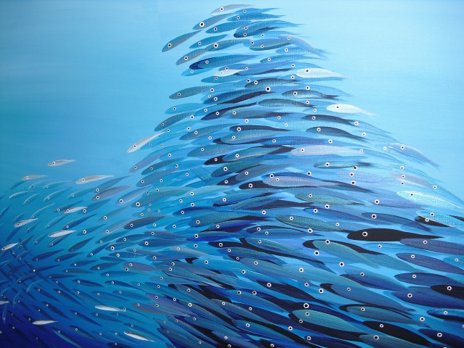
D I v e r s I t y
fofo/krk
MARINE
VAST MAJORITY: Tropical.
RICHEST: Indo-West Pacific (Red Sea and Indian Ocean to Northern Australia and Polynesia).
LARGEST NUMBER OF SHORE FISH: Southeastern Africa and Queensland.
DEPAUPERATE :Arctic and Antarctic fauna.

Slide 7
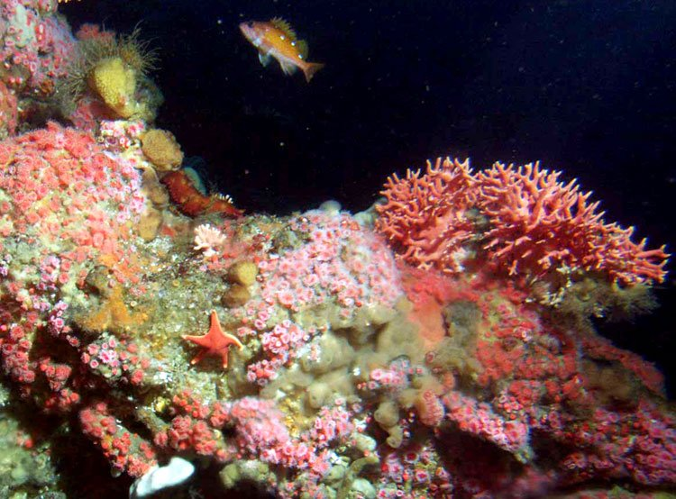

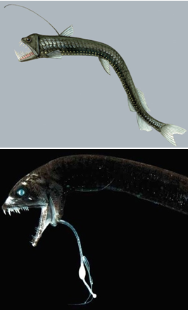
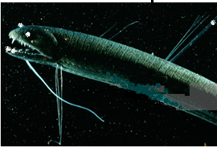

D I v e r s I t y
fofo/krk
MARINE
(DEEP SEA FISHES)
MAJORITY: Coastal or Littoral.
In THERMAL VENTS: Eastern Pacific Ocean.
DEEP SEA
Beyond the 200 m.
ZONATION:
EPIPELAGIC [open water zone]: up to 200 m MESOPELAGIC: 200 – 1000m
BATHYPELAGIC: 1000– 4000 m
ABYSSOPELAGIC or BENTHIC: Beyond 4000 m.

Slide 8
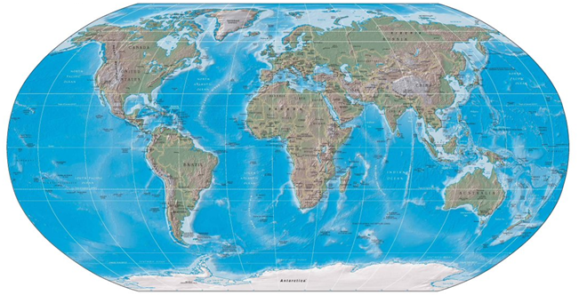
DISTRIBUTIONAL
D I V E R S I T Y
fofo/krk
LARGEST NUMBER: In the Tropics
[large number of freshwater fishes in tropical Africa, southeastern Asia and the Amazon River].
GREATEST DIVERSITY OF NON-OSTARIOPHYSAN: Africa.
ABSENCE OF INDIGENOUS FISHES CONFINED TO FRESHWATER:
Most oceanic islands and continental areas recently exposed from the last ice age (e.g., northern regions of North America, Western Europe and Asia).

Slide 9
D I V E R S I T Y
fofo/krk
BIOGEOGRAPHICAL
GEOGRAPHIC DISTRIBUTIONAL PATTERNS
or
INTERPRETIVE BIOGEOGRAPHY
TWO APPROACHES
ECOLOGICAL BIOGEOGRAPHY - Environmental factors limiting the distribution.
HISTORICAL BIOGEOGRAPHY - Origin of distributional patterns (i.e., paleontological studies).
MODES OF DISTRIBUTION
DISPERSAL: Active or Passive
VICARIANT EVENTS :Geographical range is split into
DISCONTINUOUS regions.

Slide 10
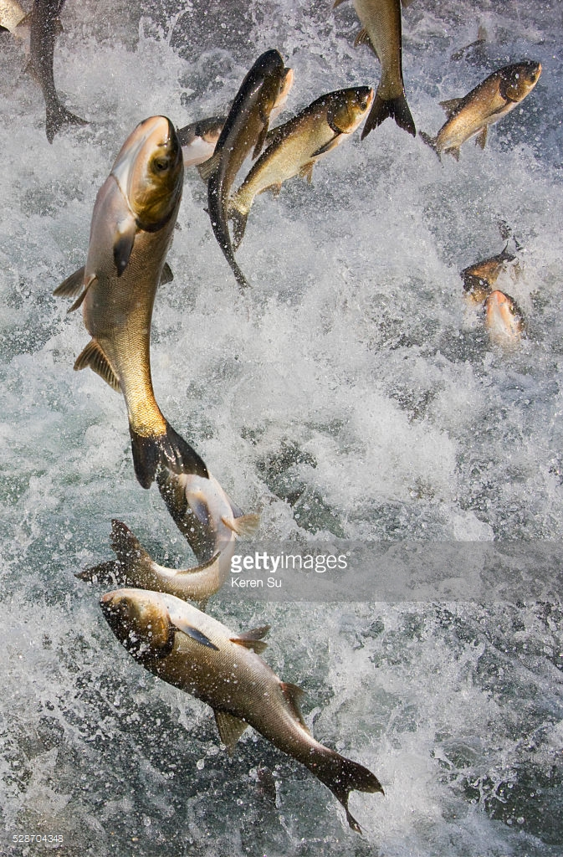
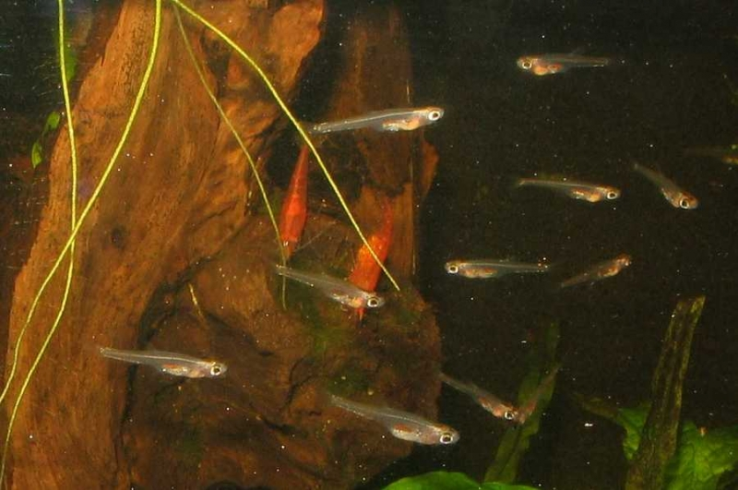
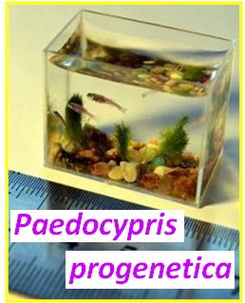
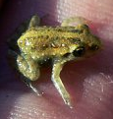
MORPHOLOGICAL
D
I
V
E
R
S
I
T
Y
fofo/krk
SMALLEST : About 6 sp.
maturing at about 7.0 – 8.0 mm WORLD'S SMALLEST
[Recorded in 2006]
Translucent fish (max. 10.3 mm; males 9.8 mm,
smalest is Female of 7.9 mm)
from
Peat swamps
of
Indonesian Islands (Sumatra & Bintan).
[was the smallest vertebrate, before the description of the smallest (7.7 mm) frog,
Paedophryne amauensis
Reported in 2012
from Papua New Guinea].

Slide 11
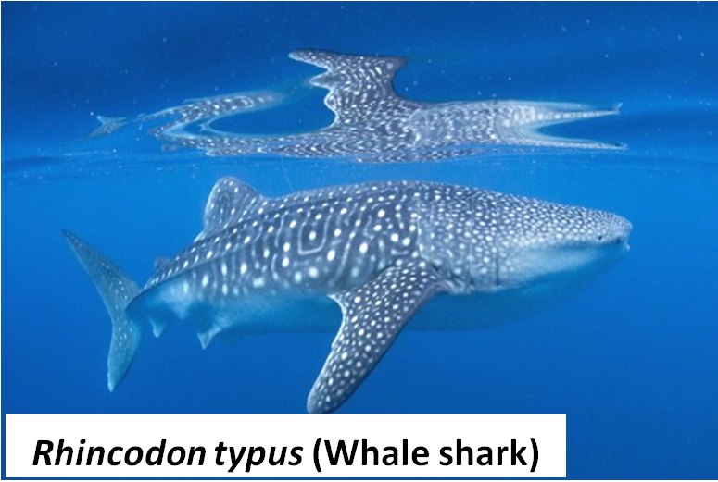
fofo/krk
D
I
V
E
R
S
I
T
Y
The LARGEST / LONGEST: 12 – 18 m, 34000 kg.
Slow moving, filter feeding.
Open waters of Tropical Oceans.
Life span: 70 years

Slide 12
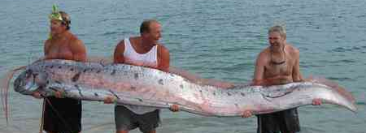
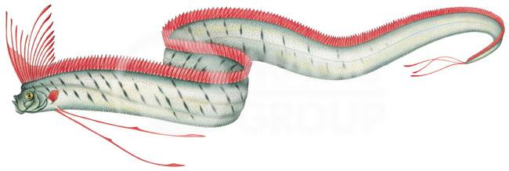
THE LONGEST BONY FISH
Found worldwide in the open ocean
[ Epipelagic to dimly lit Mesopelagic;
up to 1000 m]
LEGENDARY SEA MONSTER
Regalecus glesne [Oarfish ]
Up to 11.0 m.
OCEANODROMOUS
D
I
V
E
R
S
I
T
Y
fofo/krk

Slide 13
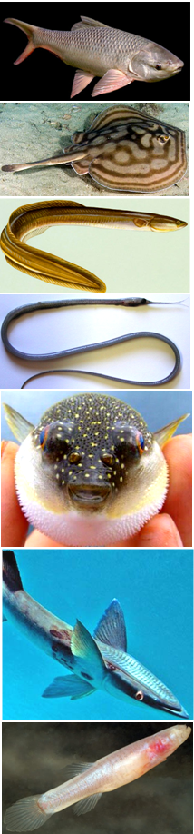
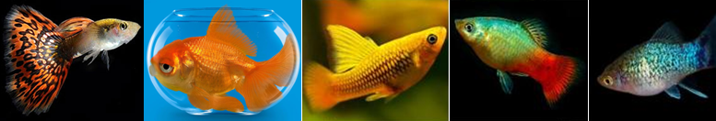
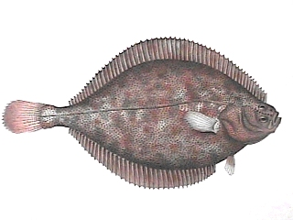
fofo/krk
D
I
V
E
R
S
I
T
Y
FORM: Spindle-shaped, snake-like (Eels), dorso-ventrally flattened, laterally compressed or globular.
Brilliantly coloured to drab.
Absence of eyes: 50 Teleosts [Cave dwellers].
FINS: absence, holdfast organs, lures, copulatory structures.
RESPIRATORY DIVERSITY: Gills to accessory structures like air bladders or even lungs.
EXOSKELETON: Body naked or covered with scales [Cycloid, Ctenoid or Ganoid].
ENDOSKELETON: Cartilaginous or Bony.

Slide 14
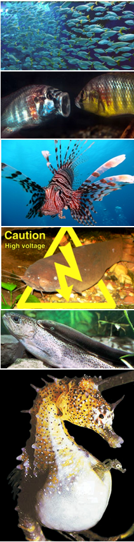
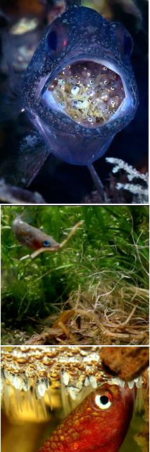
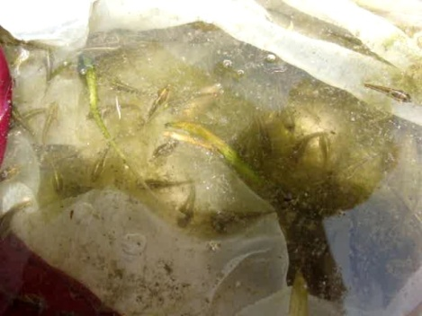
BEHAVIOURAL
fofo/krk
Schooling or Territorial
Migrating: Anadromous,
Catadromous or Diadromous,
Oceanodromous, Potamodromous.
Poisonous, venomous.
Electricity and Luminescent.
Parasitic or commensal.
Herbivorous to Carnivorous.
Eurythermal to Stenothermal.
Euryhaline to Stenohaline.
Gonochoristic to hermaphroditic.
Semelparous or Iteroparous.
Oviparous to Viviparous.
Parental care.
D
I
V
E
R
S
I
T
Y

Slide 15
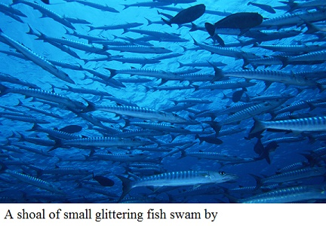
TAXONOMIC CHARACTERS
CHARACTERS: Like GOLD – they are where you find them. (Stanford Ichthyologist George Myers)
CHARACTERS: Needed to differentiate taxa and assess their interrelationships.
CHARACTERS: Variations of a homologous structure.
CHARACTERS: To be useful, must show some variation in the taxon under study.
CHARACTERS: Meristic, Morphometric, Anatomical, Osteological, Colour, Sexual dimorphism, Cytological, Molecular ( N DNA, Mt DNA).

Slide 16
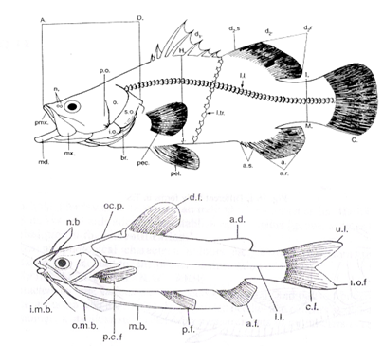
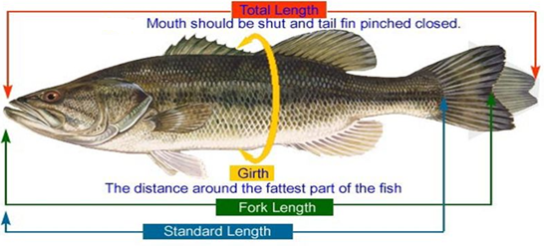
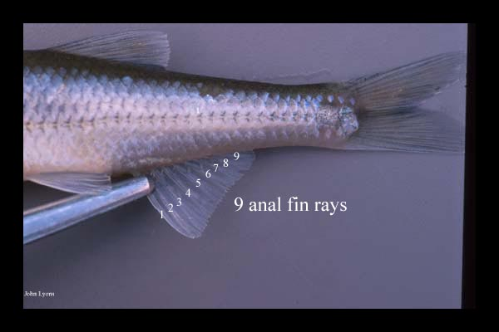
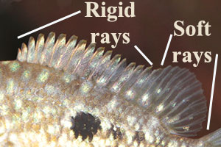
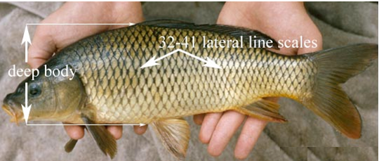
TECHNIQUES IN FISH IDENTIFICATION
MORPHOMETERY = Various body measurements and calcualation of RATIOS.
MERISTICS= Various counts.
Fin Formula:
Biii D16(III/13) P17(I/16) V9(I/8) A7(II/5) C19 L.l. 40 – 42 Ltr. 6.5 – 7.5 / 9

Slide 17
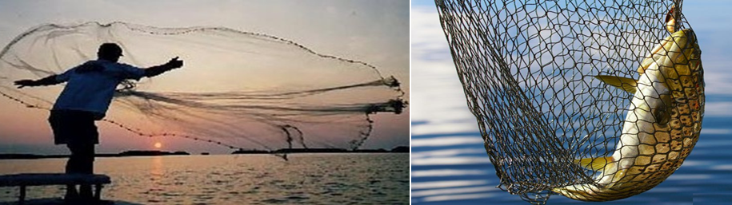
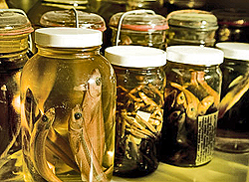
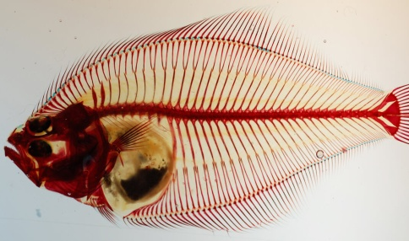
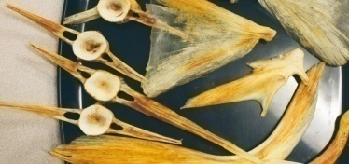
FISH
COLLECTIONS
COLLECTIONS = LIBRARIES
VOUCHER SPECIMENS : Serve as a basis of study and are retained as a reference.
CURATORS = Caring for collections and conducting observations.
PRESERVATION: In Formalin (40%) and then transferred to alcohol.
CLEARED and STAINED SPECIMENS: To study Osteology.
TISSUE COLLECTIONS: In Ethyl Alcohol or Frozen at –2°C.

Slide 18
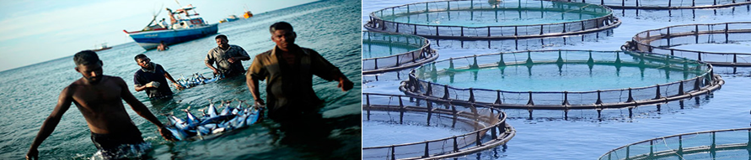
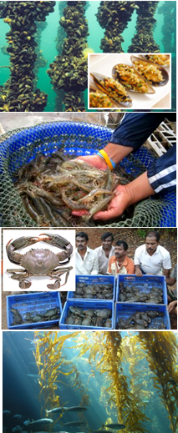
FISHERIES
ekfRl;dh
(Sing. FISHERY)
COLLECTIVE TERM: Cultivation and capture of Fish(s), Molluscans,Crustaceans, any other aquatic animal and even Sea weeds.
‘the people(fishermen) involved, species or type of fish, area of water or seabed, method of fishing, class of boats, purpose of the activities or a combination of the foregoing features’. [FAO, US]

Slide 19
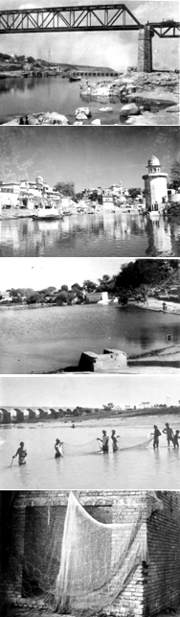
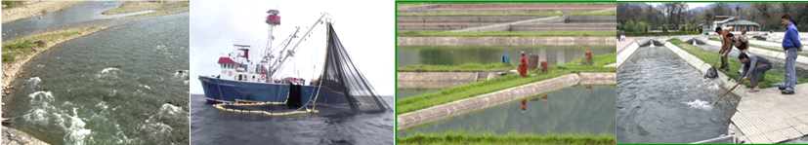
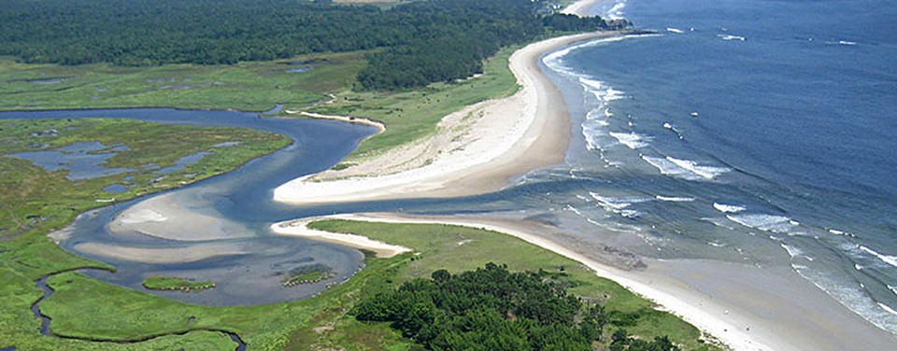
F I S H E R I E S
BASED ON ECONOMIC RETURNS AND PRODUCTION
CAPTURE FISHERY: CATCHING AND HAULING FROM NATURAL RESOURCES (RIVERS, LAKES, ESTUARIES, SEA).
CULTURE FISHERY: PRUDUCING ECONOMICALLY IMPORTANT EDIBLE FISH (OR OTHER AQUATIC ORGANISMS) IN MAN MADE AQUATIC ENVIRONMENT (FISH FARMS), ADOPTING SCIENTIFIC TECHNIQUES.
BASED ON AQUATIC ENVIRONMENT
FRESHWATER (= Inland Fisheries)
BRACKISHWATER (= Estuarine Fisheries)
MARINE
ekfRl;dh

Slide 20
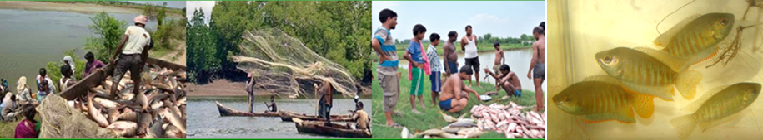
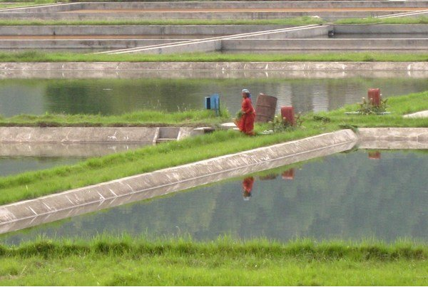
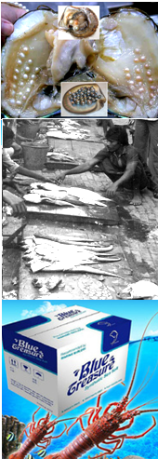
AQUACULTURE = "Blue Revolution"
[vs Green Revolution]
“the FARMING of aquatic organisms, including fish, Molluscs,
crustaceans and aquatic plants i.e., Fish farming, Shrimp farming,
Oyster farming, Mariculture, Algalculture and the cultivation of Ornamental fish”.[FAO, US]
Being practiced in China since 2500 BC
MOST COMMON FORM OF AQUACULTURE: Fish Farming.
AQUAPONICS = Conventional Aquaculture + Hydroponics [Cultivation of plants in water] in a symbiotic environment i.e., Rice in Paddy fields in combination of fish

Slide 21
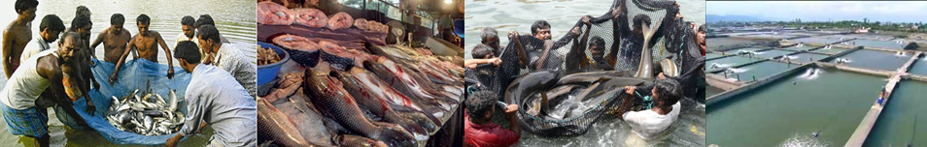

CULTIVABLE FISH
lao/kZu ;ksX; eNyh;k¡
CHARACTERISTICS
Adaptability to pond environment.
Faster growth rate.
Efficient utilization of natural food resources of the pond.
Non-predaceous and planktiphagous, preferably herbivorous
and detritus feeder.
Efficiently accepting artificial feed.
Hardy, not easily susceptible to disease.
Easy to breed and rear the seed.
Prolonged breeding period or multiple breeding frequency.
Compatible with other cultivable species.
Palatable with high nutritive value.
High market demand and high price.

Slide 22


FISH CULTURE SYSTEMS
IN ASIA
TWO MAJOR SYSTEMS
CHINESE PLOYCULTURE SYSTEM- INVOLVING ‘6’ CHINESE CARPS:
Silver carp (Hypophthalmichthys molitrix)
Grass carp (Ctenopharyngodon idella)
Bighead carp (Aristichthys nobilis)
Mud carp (Cirrhinus molitorella)
Black carp (Mylopharyngodon piceus)
Common carp (Cyprinus carpio)
2. INDIAN COMPOSITE FISH CULTURE SYSTEM:
Indian major carps (Labeo rohita, Catla catla and Cirrhinus mrigala) + Chinese carps
‘4’ FAMOUS as ‘DOMESTIC FISHES’ =
BLACK CARP + BIGHEAD + SILVER + GRASS CARP

Slide 23



INDIAN MAJOR CARPS
Labeo rohita (Rohu): Max. 1.0 m ; 18.5 kg

Slide 24






INDIAN MAJOR CARPS
Catla catla
Max. 1.8 m
36.8 kg
Cirrhinus mrigala
Max. 1.0 m
6.0 kg

Slide 25



C
H
I
N
E
S
E
C
A
R
P
S
Silver Carp: Hypophthalmichthys molitrix,
Max. 1.4 m , 50.0 kg
Bighead Carp: Aristichthys nobilis (= H. nobilis)
Max. 1.4 m, 40.0 kg

Slide 26





CHINESE CARPS
Max. 2.0 m , 100 kg
Max. 55.0 cm, 500 g

Slide 27



CHINESE CARPS

Slide 28




COMMON CARP
Cyprinus carpio
THE NUMBER ONE FISH FOR AQUACULTURE.
40–80 cm, 2–14 kg
(World record 46.10 kg)
Scale Carp: C. carpio var. communis
VARIANTS
due to
MUTATION
Mirror Crap: C. carpio var. specularis

Slide 29


ORNAMENTAL CARP
KOI
EAST ASIAN AMUR CARP
Cyprinus rubrofuscus
English, Koi = Carp; or Japanese, nishikigoi = ‘brocaded carp’
Cold-water fish: Being kept at 15–25 °C.
Common size: 30.0 – 37.0 cm; Japanese koi 55.0 – 65.0 cm; Jumbo size: 85.0 – 90.0 cm
As many as 22 varieties distinguished by colouration: white, black, red, yellow, blue and cream.
Kept for decorative purposes in outdoor koi ponds and aquaria.
MOST COMMON VARIETIES
Kohaku: white-skinned with large red markings on the top (Red and white); first ornamental variety to be established in Japan
Taisho Sanshoku: similar to the kohaku, but with small black markings.
Showa Sanshoku: black koi with red and white markings.

Slide 30

SUSTAINABLE FISHERIERS
INDIA: Xth Plan (2002 – 2007) and XI Plan (2007 – 2012)
The ‘Sustainable development of Fisheries’ requires:
“Strengthening of Database and Information
Networking for Fisheries Sector”
Involvement of components like: Remote Sensing (RS), Information Technology, GIS, GPS, Inland and Marine Fisheries Census.
FishBase [a global species database]
Fish-barcoding [=FISH-BOL campaign]
Fishery Extension Services
Welfare Schemes, Fishery Policies, Laws / Acts / Regulations

Slide 31



KEEP FISHING
THE
CAREER
B
E
S
T
L
U
C
K
of

